Slide 1
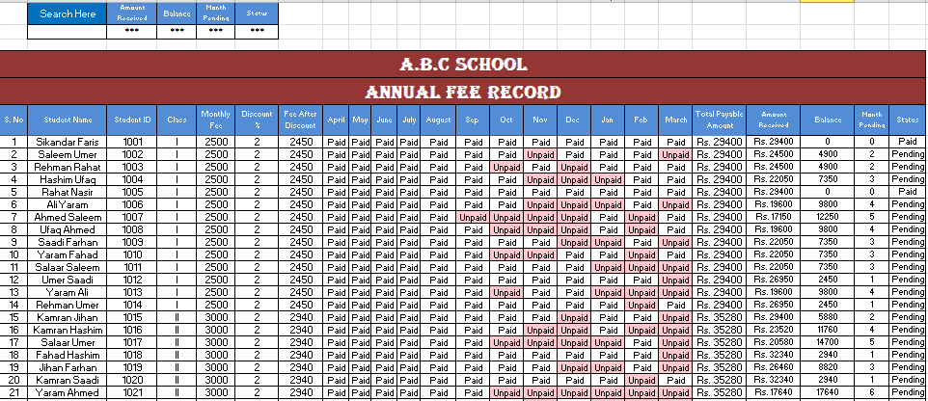
Annual Fee Record
Made By:-
Uroosa Ikhlaq Ahmed (Leader) , Aneela Shah, Ayesha Arshad

Slide 2
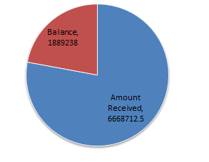
According to the Data record

Slide 3
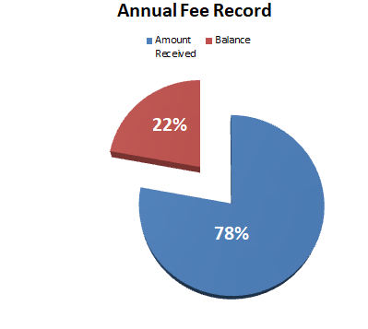
22% Amount is still pending of the school

Slide 4
Uses
This file will help to any one for maintain their school fee record.
Search engine of the file can easily find data for any students.
It keeps record and ease to access.

Slide 5
In this record you can also search the data of any student by Student ID Number

Slide 6
THE END
THANK YOU

